Slide 1


Talking the Talk: Making Research Understandable
EdFund Policy Fellows Workshop #6
February 19th, 2026

Slide 2

AEFP!
EdFund Events!
March 18th – Fellows Workshop, 9:30am-4pm
March 19th – EdFund Happy Hour at the Palm, 6:30-7:30pm
March 20th – EdFund Lunch Panel at the Palm, 11:45-1:45pm
Drink Menu!
Beer Reviewed (beer options)
Second reviewer options (wine options)
Double Blind (Cocktail options - The Meta Mule & Funding Fizz)
Notes:
Reminder to check out our Workshop Hub!
https://www.edfundworkshop.org/our-fellows
PSW: EdFundFellow25

Slide 3
School Finance Policy Workshop Series
Workshop 1 - Aug: Ed Funding Policy Deep Dive (Zahava)
Workshop 2 - Sept: Understanding the Policy Landscape
Workshop 3 - Oct: In-Person Panel with EdFund Board!
Workshop 4 - Nov: Data Hygeine (edfinr with Alex Spurrier)
Workshop 5 - Jan: Influencing Policy (Colorado advocates)
Workshop 6 - Feb: Communicating Research (today!!)
Workshop 7 - March: In-Person pre-AEFP workshop
Workshop 8 - April: Engaging with the Press (journalists)

Slide 4
Hari Sevugan
Selected Roles
Senior spokesman, Obama–Biden presidential campaign
National Press Secretary, Democratic National Committee
Deputy Campaign Manager, Pete Buttigieg 2020 campaign
Partner, 270 Strategies political consulting firm
Founding partner, Narrator strategic communications firm

Slide 5
Bethany Little
Selected Roles
Managing Principal, EducationCounsel
Chief Education Counsel, U.S. Senate HELP Committee
White House Domestic Policy Council staff
Managing Partner, America Achieves
Vice President for Policy & Advocacy, Alliance for Excellent Education

Slide 6
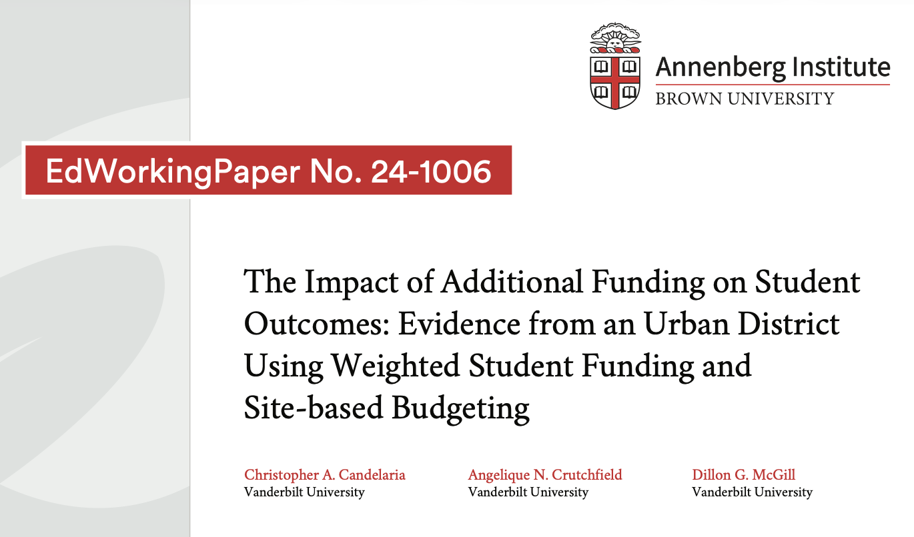
Time to Practice!
Using Candelaria et al (2024), collaborate with your group to draft a few brief talking points that distill and communicate the paper’s findings for specific audiences:
Break Out Rm 1 = Policymakers & Advocates
Break Out Rm 2 = Journalists
Break Out Rm 13= School communities (ex. PTAs, School Boards)

Slide 7
Candelaria & colleagues (2024)
Motivation: Limited causal research regarding how school-level, student-based budgeting (SBB) funding allocations within a district affect student outcomes and the need to identify the specific mechanisms that explain these results
Policy Context: Compares student outcomes from before and after implementation of SBB (which includes weighted student funding (WSF) + site-based budgeting)
  2015-2016 SY = First year of SBB implementation
Research Design: Concurrent embedded mixed methods design!
  Quant: Synthetic difference-in-differences (SDID) approach (2 RQs)
  Qual: Interviews with Principals (1 RQ)
Sample: 61 elementary schools within 1 large, urban school district in the Southeast US
Data Sources:
  Quant: School- & student-level data including test scores, attendance, and disciplinary records from 2011-12 to 2021-2022
  Qual: 11 semi-structured interviews with elementary school Principals (18% of quant sample) in 2021-2022 SY. 6 in high-dosage schools, 5 in low-dosage
Findings: That’s up to you to translate!!

Slide 8
AEFP Reminders
All rooms are booked at Club Quarters​
Please keep receipts for airfare reimbursement​
Follow up email will include more details for our in-person workshop in March!​
If you need to request a laptop for the workshop, email Shrien by end of February
Notes:
Reminder to check out our Workshop Hub!
https://www.edfundworkshop.org/our-fellows
PSW: EdFundFellow25

